Slide 1
Preferences, Constraints, and Choice
Rajiv Sethi and the CORE Team
September 27, 2021

Slide 2
Overview
Constraints and trade-offs
Production functions
Feasible Sets
Marginal Rate of Transformation
Indifference Curves
Marginal Rate of Substitution
Optimality conditions
Reading: The Economy Unit 3 Introduction and 3.1-3.5

Slide 3
Constraints

Slide 4
Constraints and Trade-offs
Economic decisions involve trade-offs
If you spend more money on shoes you’ll have less money for clothes
If you spend more time hiking you’ll have less time for reading
Decisions will depend on budgets, prices, and preferences
Example: you have a budget of 24 hours/day, how to allocate it?
More time studying leaves less time for other activities
But less time studying means lower grades
Study will depend on effectiveness of study (technology)
And will also depend on the value of grades (preferences)

Slide 5
Production Functions
A production function describes relation between inputs and outputs
Earlier example: labor and energy were inputs, cloth was output
Similarly: study time can be viewed as an input with grades as output
Hours of Study
0 | 1 | 2 | 3 | 4 | 5 | 6 | 7 | 8 | 9 | 10 | 11 | 12 | 13 | 14 | 15+
0 | 20 | 33 | 42 | 50 | 57 | 63 | 69 | 74 | 78 | 81 | 84 | 86 | 88 | 89 | 90
Grade

Slide 6
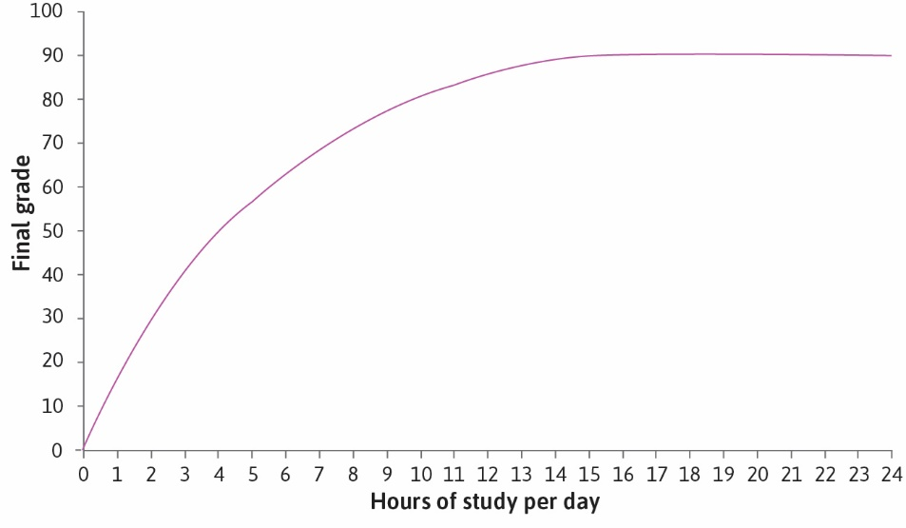

Slide 7


Slide 8


Slide 9
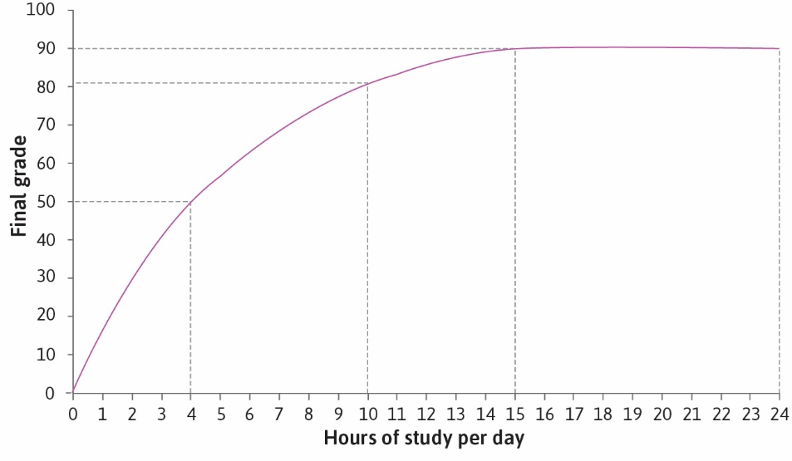

Slide 10
Average Product
Average product is total output divided by total input
When input is 4 hours, average product is 12.5
On average, each hour gets you an extra 12.5 grade points
What is the average product when input is 10 hours?
AP is the slope of line from origin to point on production function
Hours of Study
0 | 1 | 2 | 3 | 4 | 5 | 6 | 7 | 8 | 9 | 10 | 11 | 12 | 13 | 14 | 15+
0 | 20 | 33 | 42 | 50 | 57 | 63 | 69 | 74 | 78 | 81 | 84 | 86 | 88 | 89 | 90
Grade

Slide 11
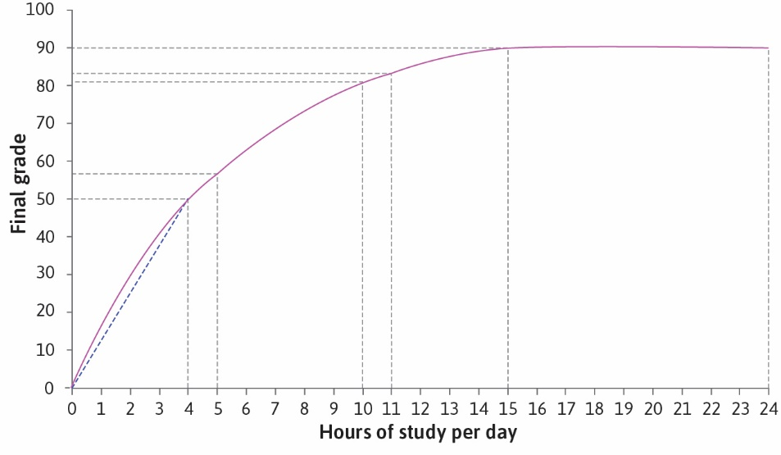

Slide 12
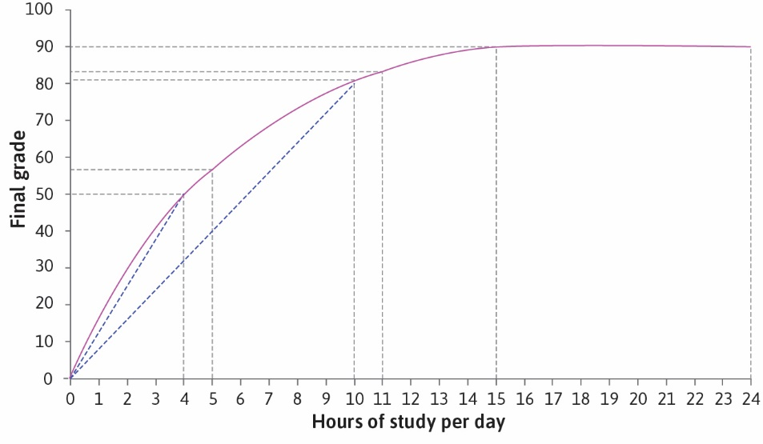

Slide 13
Marginal Product
Suppose you raise inputs by a small amount, so output rises a bit
Marginal product is the increase in output divided by increase in input
MP is the slope of the production function itself
Approximately equal to extra output from one extra unit of input
When input is 4, marginal product is between 7 and 8 (why?)
What is marginal product (approximately) when input is 10?
Hours of Study
0 | 1 | 2 | 3 | 4 | 5 | 6 | 7 | 8 | 9 | 10 | 11 | 12 | 13 | 14 | 15+
0 | 20 | 33 | 42 | 50 | 57 | 63 | 69 | 74 | 78 | 81 | 84 | 86 | 88 | 89 | 90
Grade

Slide 14
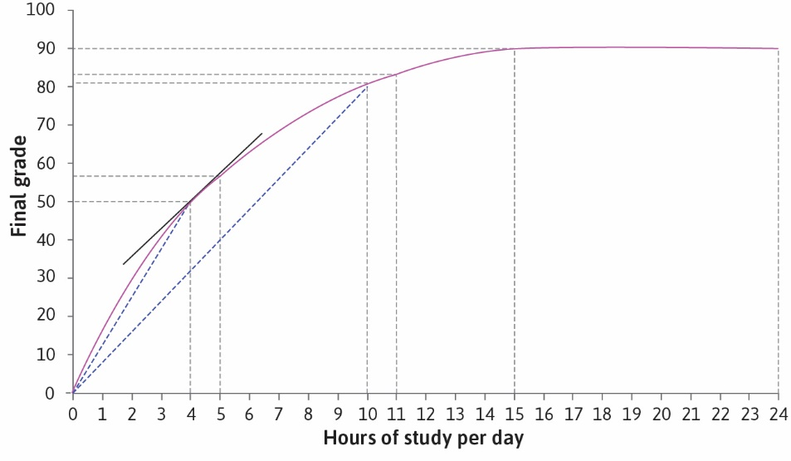

Slide 15
Diminishing Marginal Product
Marginal product in this example is diminishing
The more you study, the less an extra study hour raises grade
Does this make sense in this context?
Would you expect this to hold more generally?
For example if input is fertilizer on a farm?
Can you think of other examples?
Hours of Study
0 | 1 | 2 | 3 | 4 | 5 | 6 | 7 | 8 | 9 | 10 | 11 | 12 | 13 | 14 | 15+
0 | 20 | 33 | 42 | 50 | 57 | 63 | 69 | 74 | 78 | 81 | 84 | 86 | 88 | 89 | 90
Grade

Slide 16
Feasible Sets

Slide 17
Trade-offs
An hour of study time is a lost hour of free time (or time for other things)
To get higher grades, we sacrifice free time (trade-off)
We can write the production a bit differently in this way
With free time on the vertical axis, we get a downward sloping curve
What’s the grade if free time is 13?
Hours Free
<9 | 10 | 11 | 12 | 13 | 14 | 15 | 16 | 17 | 18 | 19 | 20 | 21 | 22 | 23 | 24
90 | 89 | 88 | 86 | 84 | 81 | 78 | 74 | 69 | 63 | 57 | 50 | 42 | 33 | 20 | 0
Grade

Slide 18
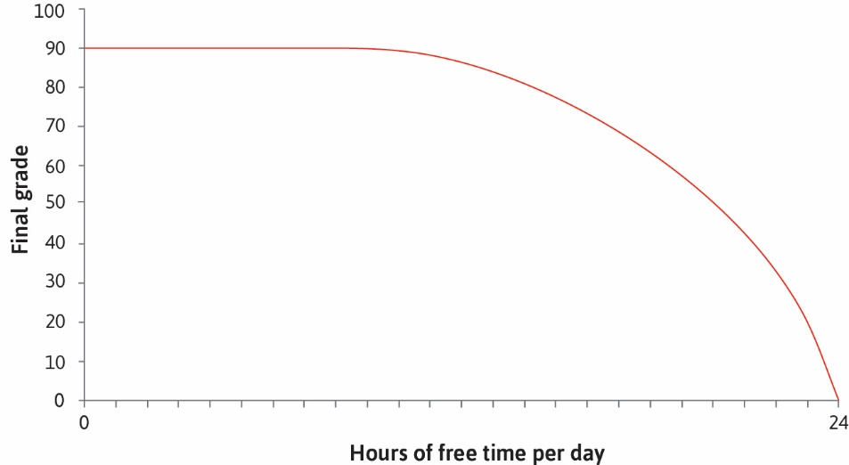

Slide 19
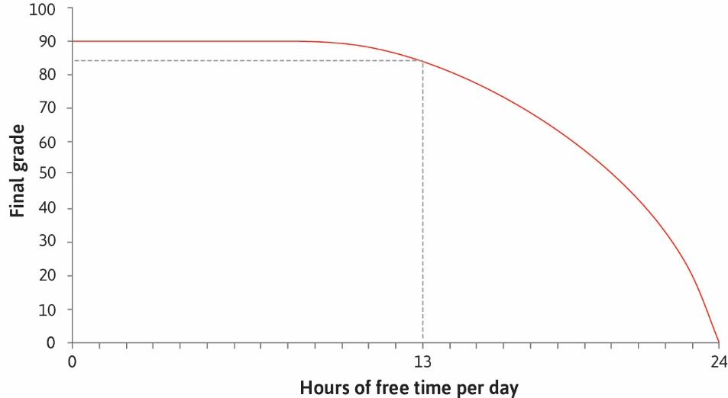

Slide 20
Feasible Sets
Some combinations of free time and grades are infeasible
For example: 20 hours free, grade 70 can’t be attained
Other combinations are feasible but wasteful
For example, 10 hours free, grade 70 is attainable but one can do better
These points lie above (infeasible) or below (wasteful) the curve
The feasible set contains all attainable points (even if wasteful)
The boundary of the feasible set is the feasible frontier
Hours Free
<9 | 10 | 11 | 12 | 13 | 14 | 15 | 16 | 17 | 18 | 19 | 20 | 21 | 22 | 23 | 24
90 | 89 | 88 | 86 | 84 | 81 | 78 | 74 | 69 | 63 | 57 | 50 | 42 | 33 | 20 | 0
Grade

Slide 21


Slide 22
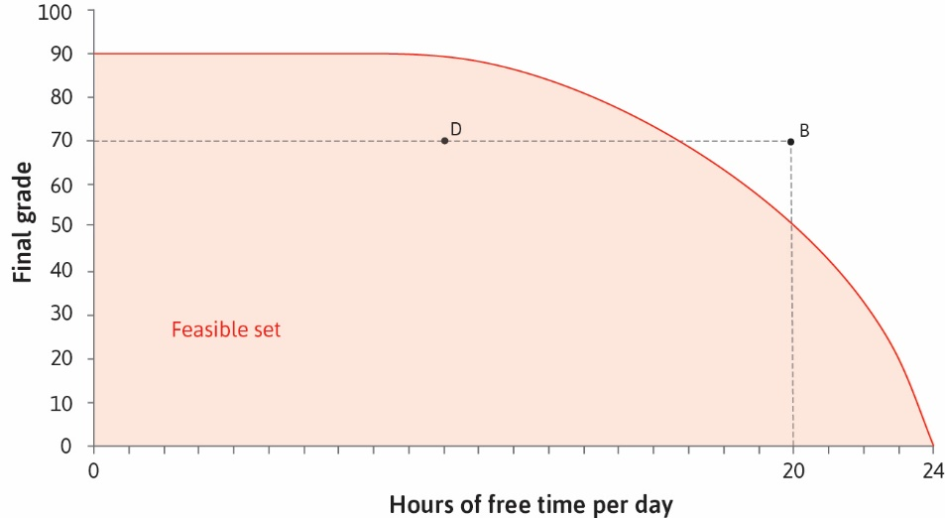

Slide 23
Marginal Rate of Transformation
The marginal rate of transformation is the slope of the feasible frontier
This tells us how easy it is to transform free time into grades
Approximately equal to the grade increase obtained by one less free hour
When free time is 20, MRT is approximately 7
When free time is 14, MRT is approximately 3
The higher the grade to begin with, the harder it is to raise it further
Reflecting diminishing marginal product
Hours Free
<9 | 10 | 11 | 12 | 13 | 14 | 15 | 16 | 17 | 18 | 19 | 20 | 21 | 22 | 23 | 24
90 | 89 | 88 | 86 | 84 | 81 | 78 | 74 | 69 | 63 | 57 | 50 | 42 | 33 | 20 | 0
Grade

Slide 24
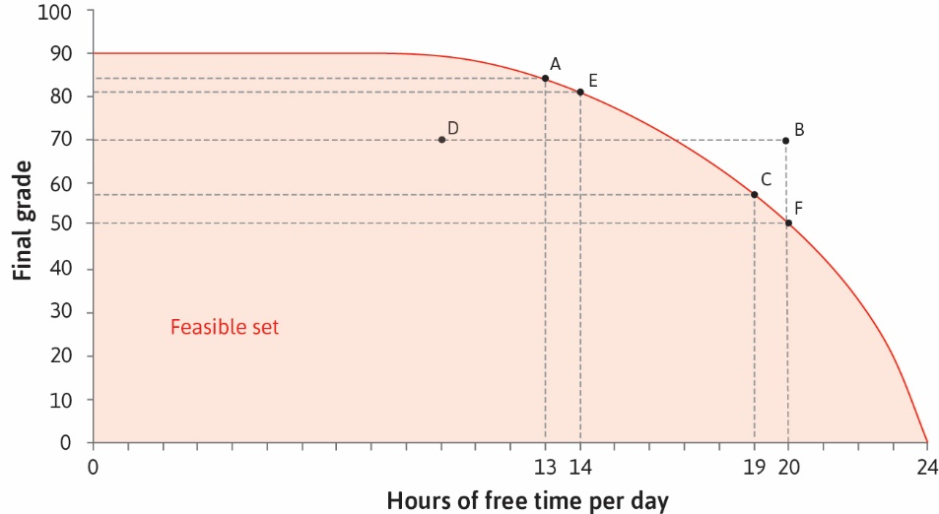

Slide 25
Choice
We cannot choose infeasible combinations of inputs and outputs (like B)
And would rather avoid wasteful combinations (like D)
But many combinations are neither infeasible nor wasteful
They lie of the feasible frontier
Example: points A, E, C, F
How do we choose among these?
Depends on preferences

Slide 26
Preferences

Slide 27
Montonicity
Disregard feasibility for the moment, think only about preference
Suppose we prefer more free time to less, prefer higher grades to lower
That is, preferences are monotonic in free time and grades
If two combinations have same grades, prefer one with more free time
If two combinations have same free time, prefer one with higher grade
Example: prefer A to B and prefer D to C on following slide
But what about comparison between A and D? Which is better?
Depends on preferences; value of free time relative to grades

Slide 28
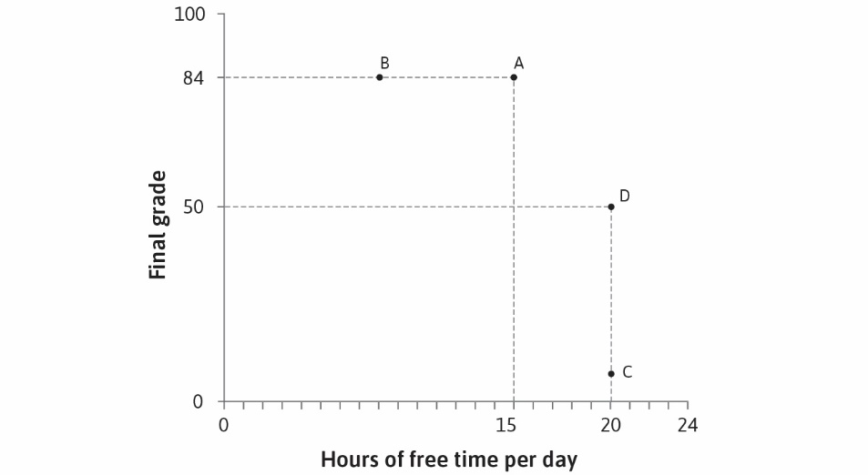

Slide 29
Indifference Curves
We can represent an individual’s preferences using indifference curves
An indifference curve connects together all equally valued points
For any given point, one can ask: which other points have same value?
Example: points A, E , F , G , H, and D on following slide
Points B and C will be on lower indifference curves
For the particular preferences shown, B is preferred to C
Points on lower indifference curves are less preferred to those on higher
But preferences differ across individuals, some might prefer C to B

Slide 30
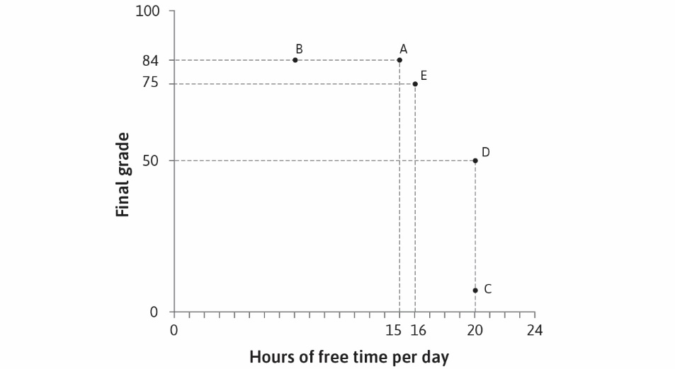

Slide 31


Slide 32
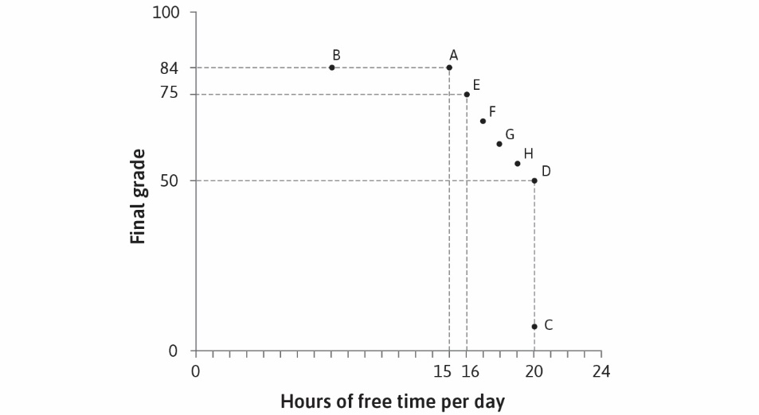

Slide 33
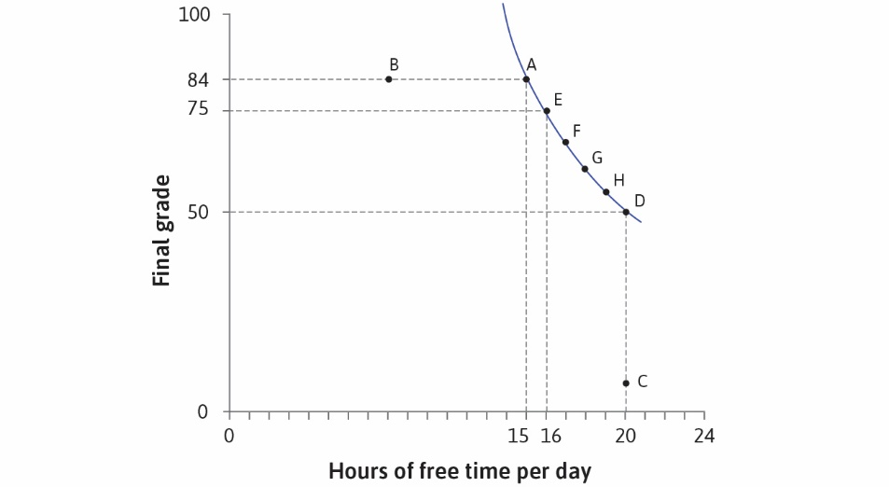

Slide 34
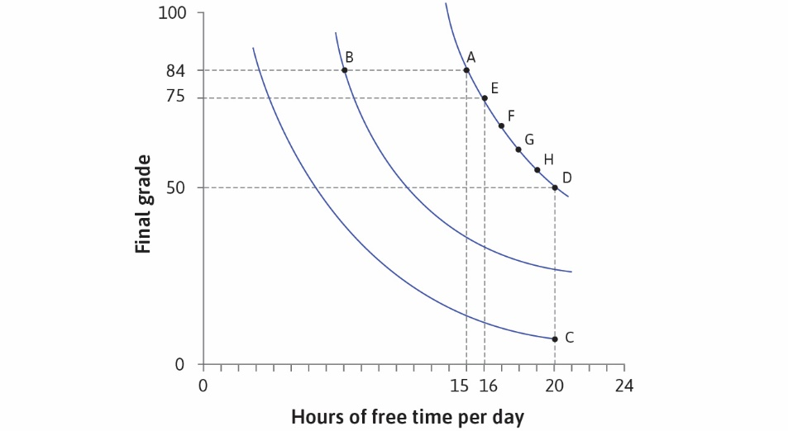

Slide 35
Marginal Rate of Substitution
The marginal rate of substitution is the slope of the indifference curve
Tells us how much we are willing to give up one thing to get another
When free time is low, willing to give up more in grade for an extra hour
Example: at 15 hours free, willing to give up 9 points for extra hour
See points A and E on slides to follow
At 19 hours free, extra hour is less valuable, willing to give up 4 points
See points H and D on slides to follow
Note: MRS tells us only about preferences, regardless of what is feasible

Slide 36
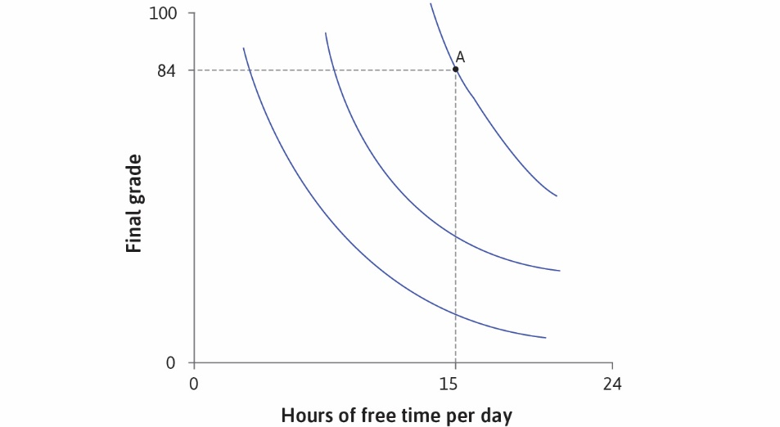

Slide 37
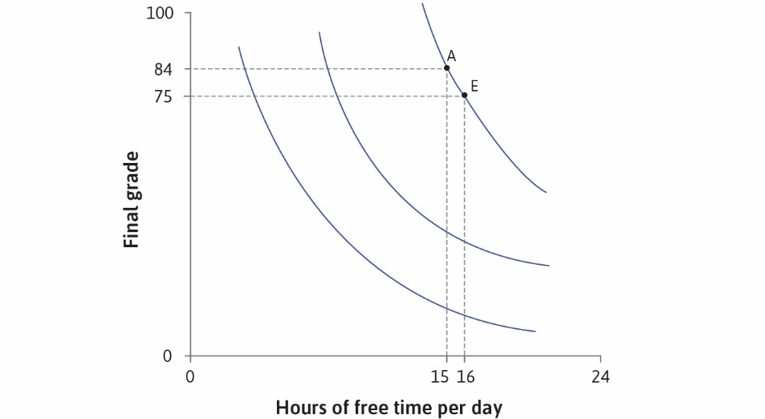

Slide 38
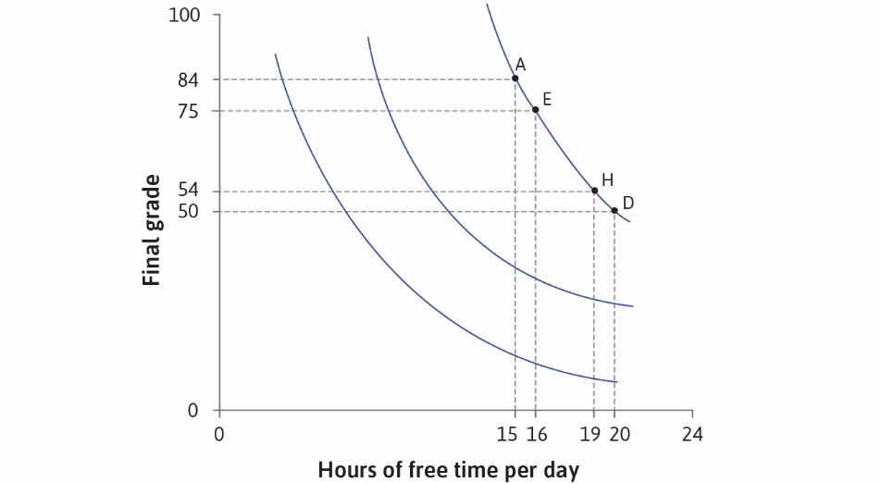

Slide 39
Optimal Choice

Slide 40
Optimal Choice
Given technology (feasible set) and preferences, what should we choose?
Which point on feasible frontier is best?
The point on the highest attainable indifference curve
This will be a point of tangency, where MRS = MRT
The highest indifference curve touches the feasible frontier just once
Otherwise it won’t be the highest (why is this true?)

Slide 41
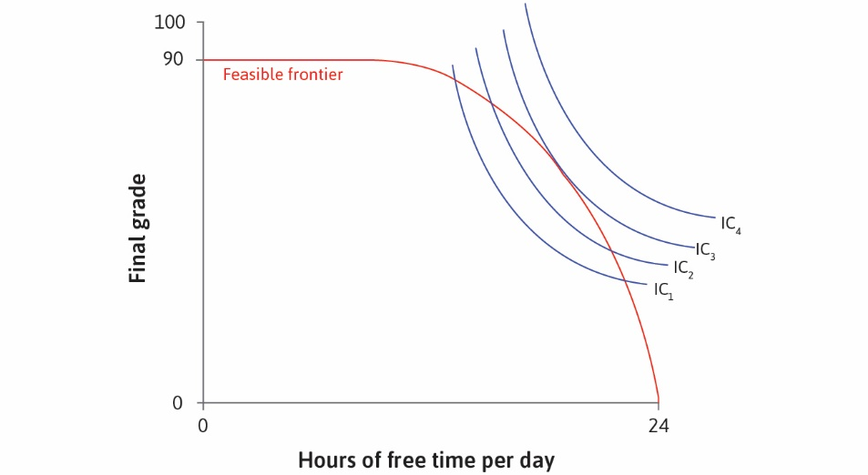

Slide 42
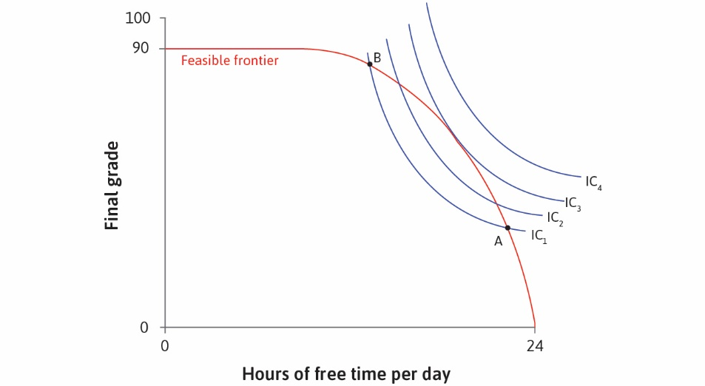

Slide 43


Slide 44


Slide 45
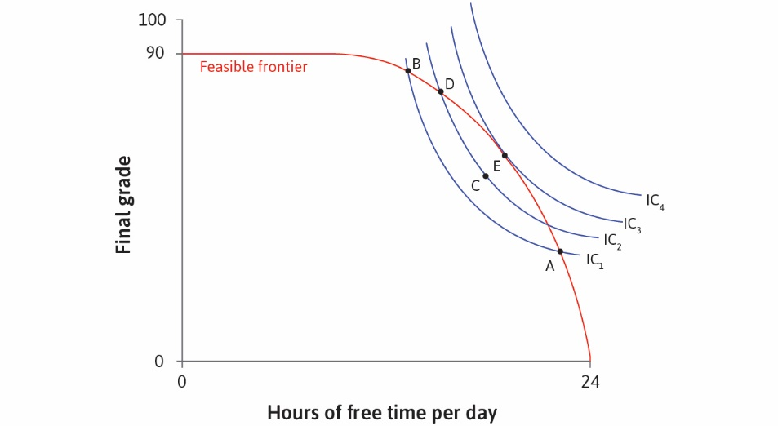

Slide 46


Slide 47
